Slide 1
GEP Repository and Data Organization
Quick apology, I’m going to go fast, and some content here is not relevant for all audiences.
But in some ways, this is how we document our (emerging) lab standards.

Slide 2
Overall Goal
Enable a random user to run a single file, run_gep.py, and generate all of the outputs and the full supplementary information manuscript.
In this age of AI, “click-botton” replicability is EVEN MORE important.
But it’s very challenging
Requires organizing our base data, code, execution runtime, and download services
Also requires having a standardized typology of results

Slide 3
Overall Goal, specific
Each service MUST output the following
Global GEP Total in base year
A CSV of GEP by country in base year, formatted “correctly”
A .GPKG map of GEP by country in base year
A PNG of that map
Services may have:
Sub-services (e.g., commercial agriculture distinguishes pasture and cropland GEP)
GEP by year
GEP by country and year
GEP by country, year, and sub-service

Slide 4
Building the Supplemental Information
Each service will have a run.py file runs the calculations, generates the outputs, AND BUILDS THE SI MANUSCRIPT
We’ll use Quarto QMD as the canonical form
But will have many other possible outputs, like ipynb notebooks that we can host on the cloud.
“Quarto convert notebook.ipynb” will create a QMD and vise-versa
The QMD file must be present, and we will use this to generate an ipynb as the last step (but don’t run it, cause that causes havoc in git).
QMD also renders to Latex-style PDF, Word, Google Doc, PPT, etc
Biggest challenge: use latex for equations (or worst case, embed a png)

Slide 5
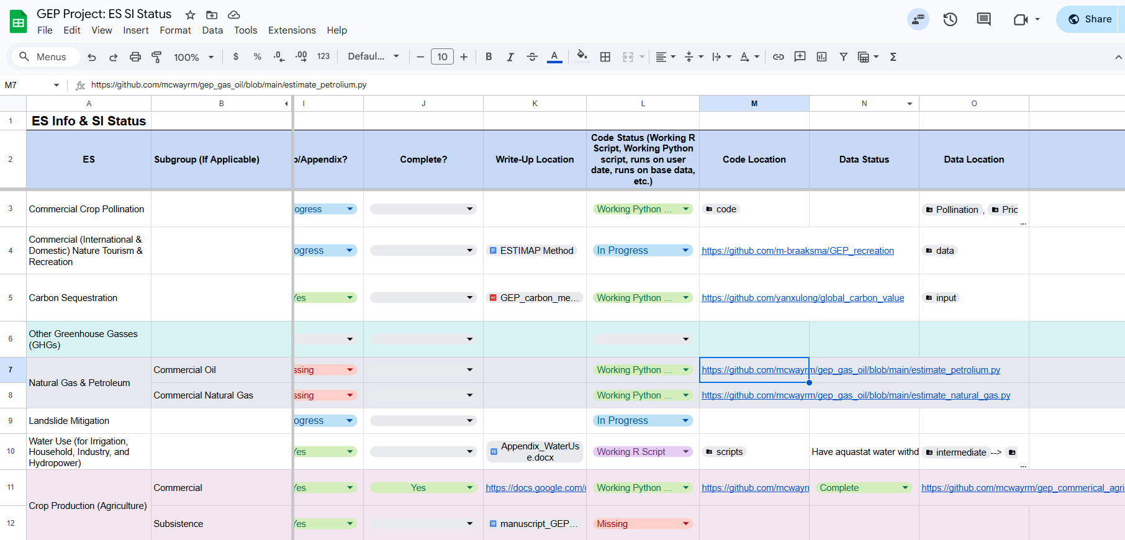
Natalie’s Master GEP status sheet

Slide 6
Coding practices to make this all work

Slide 7
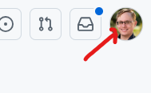
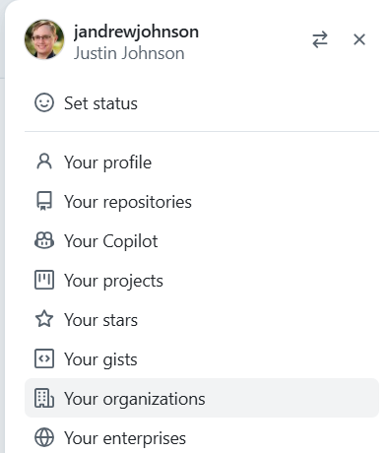
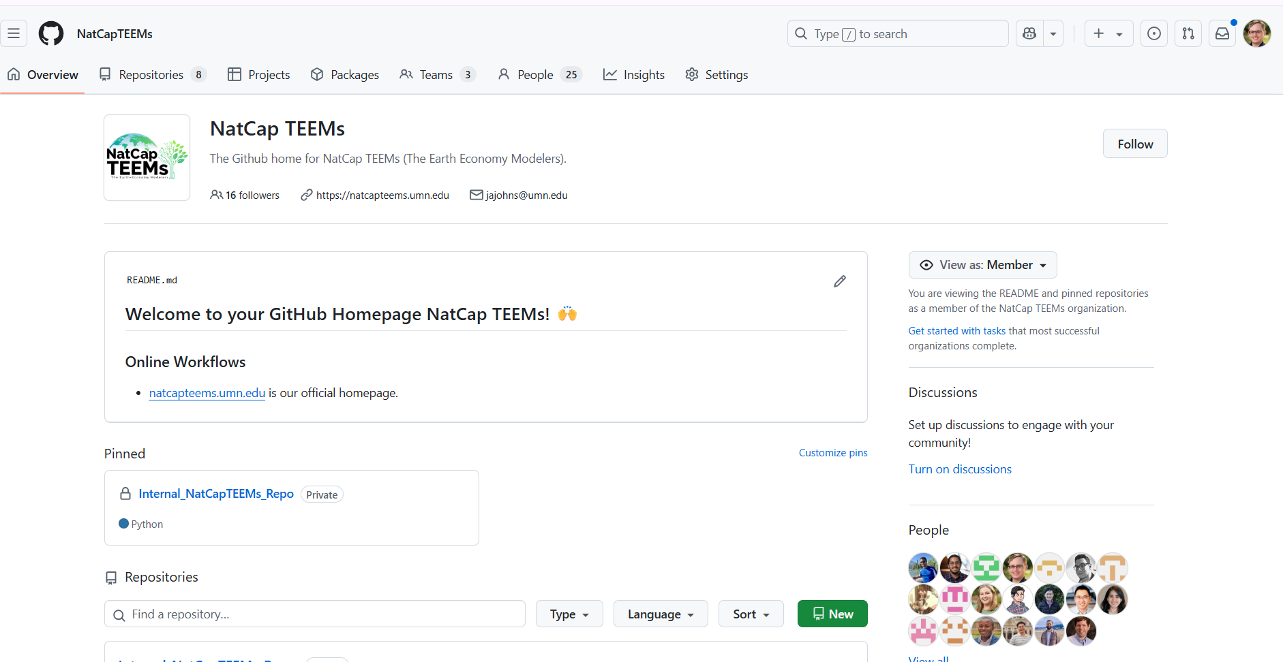
We use our Github Organization
https://github.com/NatCapTEEMs
You can find it in Your organizations
Once you’re a member, you have read/clone access to all our repositories

Slide 8
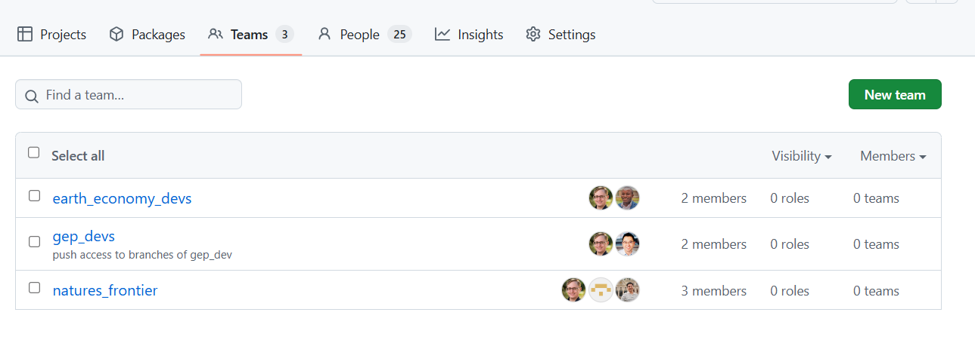
Within our Organization, we use Teams
Being on a Github Team is only necessary if you need to push directly to the repos
This usually isn’t needed because we use Pull Requests
Contact me if it’s needed

Slide 9
GEP vs Global_Invest repositories
GEP_Dev will be our internal private repository. Upon publication, this will be copied to GEP (no dev).
GEP repo will be relatively small because it will only call modules from the global_invest_dev repo
But it will also generate the actual GEP manuscript
Global_invest_dev will house global ES calculation AND valuation, which is basically all of the work in GEP
Why the separation? GEP is just one possible application of Global InVEST. Others include GTAP-InVEST, Jeronimo’s Time-Series of historical data (eventually), or the next big lab paper, Ecosystem Service Projections.

Slide 10
A Quick Primer on Code Organization
Project, projects, repos and modules

Slide 11
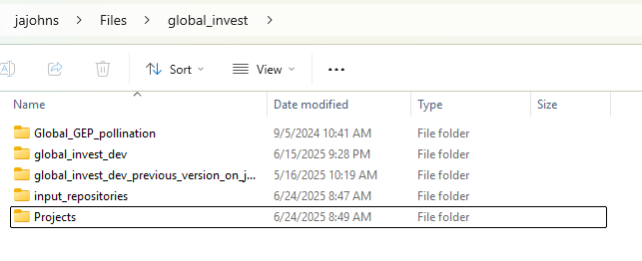
Project folder
Can place anything here
Data
Manuscripts
Memes
Two key folders
Global_invest_dev is a repository (got there by git clone)
Projects is a special folder where all ProjectFlow outputs are saved
Sorry-not-sorry it’s confusing to have a Projects in Project folder.

Slide 12
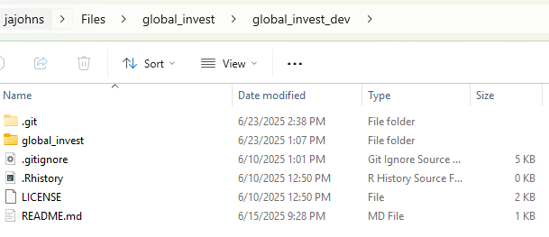
Repo folder
Hidden .git folder is where all the version control magic happens
Contains files that describe the code
But isn’t actually where you put the code you import

Slide 13
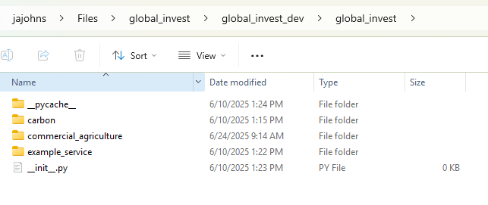
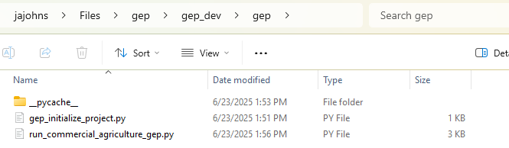
Module folder
The __init__.py makes it importable as a python module
This is where the actual organization of our GEP services will live.

Slide 14
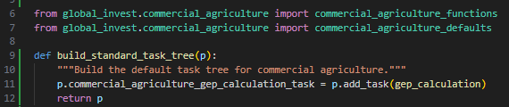
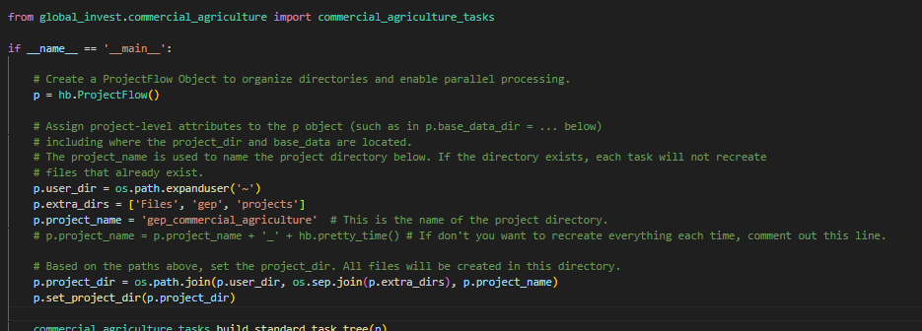
Why this structure?
It makes our code importable as a python module!
And works well with our run.py file
And works well with our forthcoming User Interface!

Slide 15
Data practices

Slide 16

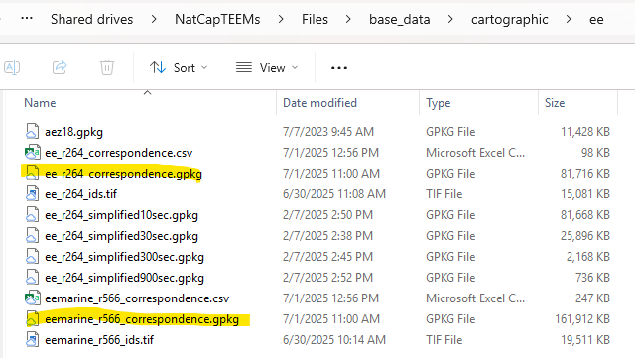
EE-spec country names (or why I’m not giving detailed results today…)
My bad, but I failed to clarify in advance that when using FAO, you should use what they call the “M49” id. This is the actual ISO3 code. There is a competing FAO id, which they also include. Don’t use that.
I have now updated the base_data, and specifically the EE country map to fix this

Slide 17
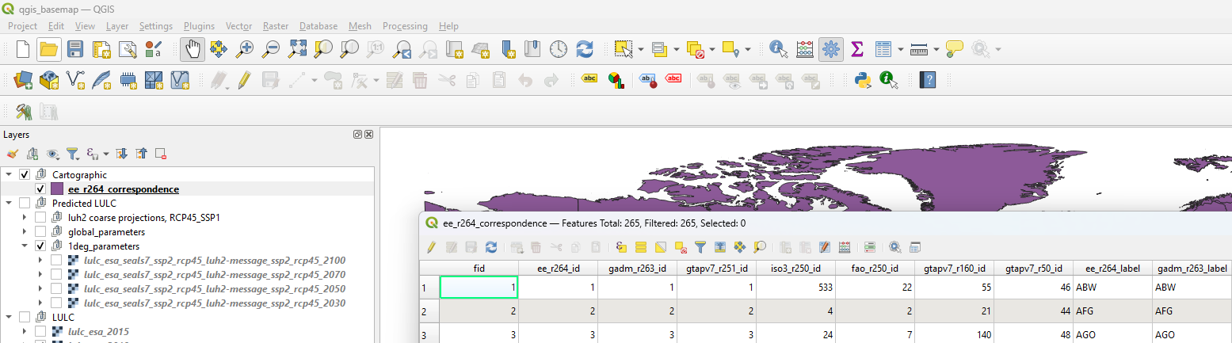
Ee_r264_id and the corresponding ee_r264_label is the superset of all possible country naming conventions

Slide 18
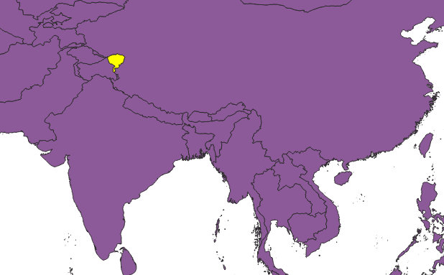
Disputed territories (or, places not to visit)
For instance here:
GADM (the best vector map) says it’s disputed
ISO3 says it’s China
I don’t care about geopolitics (or do I?), but I do care about good database management, so, we need to be unambiguous about all these
Hence ee_r264_correspondence.gpkg

Slide 19
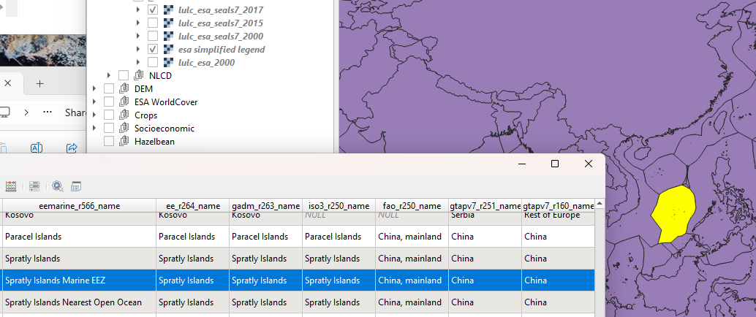
But what about Marine?
It’s much much worse
I’m looking at YOU, Spratly Islands…

Slide 20
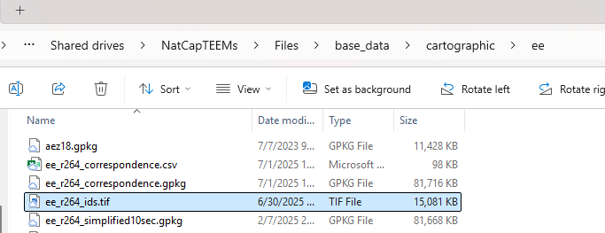
Additional Feature: Very Fast Zonal Statistics
Hb.zonal_statistics() is about 3-10x faster than Pygeoprocessing and about 50-20000x faster than QGIS
Relies on preprocessed “pyramidal” id_rasters
hb.zonal_statistics(zone_values_path, aggregate_vector_path, zone_ids_raster_path)

Slide 21
Discussion of one outstanding issue

Slide 22
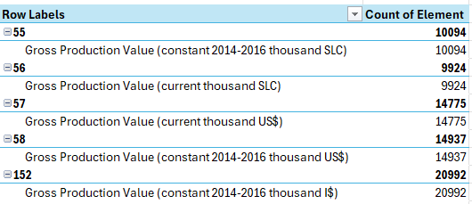
FAO produces multiple outputs, but NONE of these are reported for all years?
What is the best way to address this?
58 Gross Production Value (constant 2014-2016 thousand US$) 1000 USD seems best in terms of definition
152 Gross Production Value (constant 2014-2016 thousand I$) 1000 Int$
Is most comprehensive

Slide 23
Appendix
And/or not yet decided

Slide 24
Make sure correct results don’t get recomputed
if p.run_this:
crop_result = commercial_agriculture_functions.calculate_gep(p.base_data_dir, commercial_agriculture_defaults.DEFAULT_CROP_ITEMS)

Slide 25
Document correct choice about precaching big results
E.g., seasonal water yield global

Slide 26
Run structure
I clone the repo from natalie’s spreadsheet into C:\Users\jajohns\Files\global_invest\input_repositories\<service>
I run the code as is to ensure it works and generate the total GEP value we will validate the NEW code against. Gep_agr.py
I then run it again but with the code organized into the proper part of the base_data
I then make a minimal, preconfigured run.py in global_invest/<service>, which uses a minimal ProjectFlow instantiation.

Slide 27
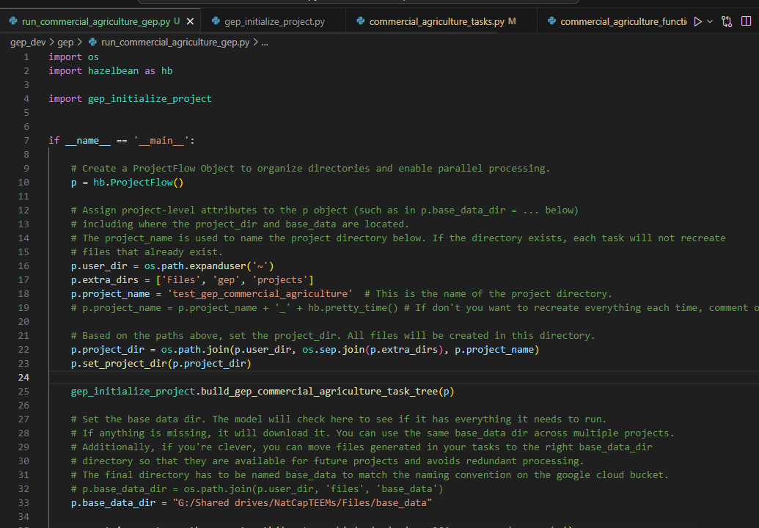
The run file
Project name sets where things save
The build Task Tree function defines the logic
The base_data_dir should point to our Google Drive
(this is a change from my recommendation before of making it local, which is faster and safer, but meh)

Slide 28
